Slide 1
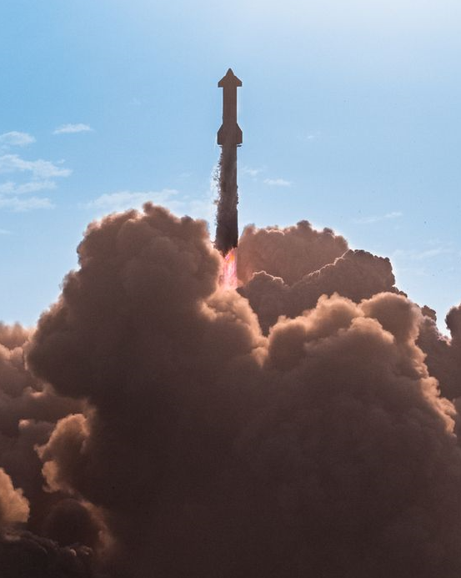
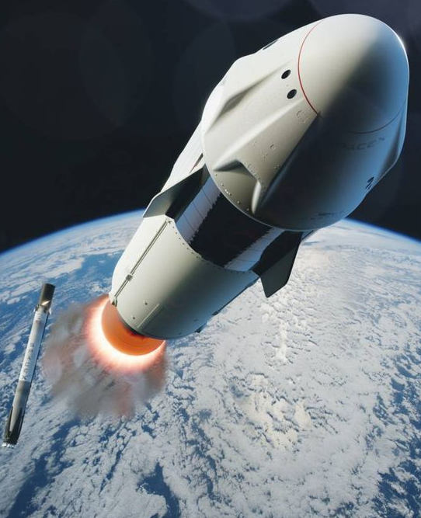
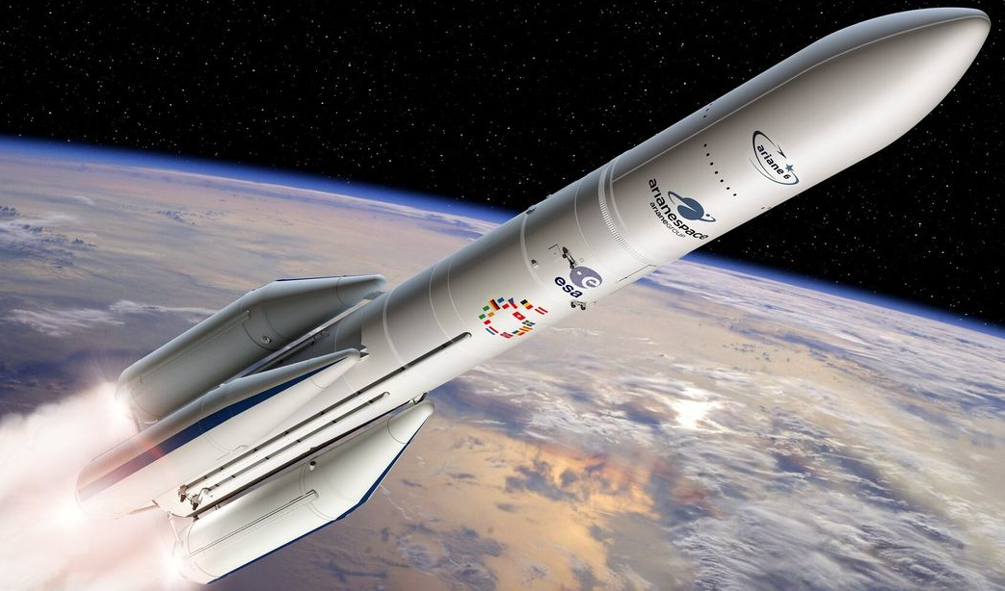
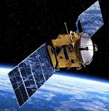
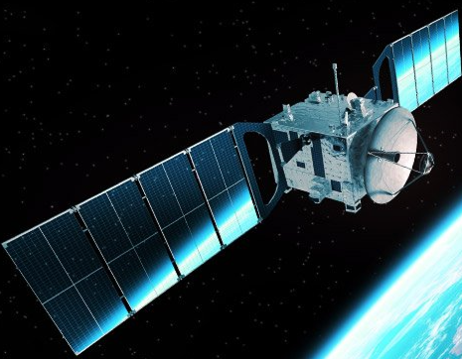
Development of Latching Solid-State Relays for the Direct Replacement of Electromechanical Relays in Space, Aerospace/Defence and Industrial Control System Applications
Thomas Bayat
CEO and Managing Director MSc. optoelectronics MIEEE, MIOD

Slide 2
Contents
Comparison between EMRs and SSRs.
Failure Modes of EMRs.
Isocom Latching Solid State Relay Development.
Summary of LSSR Developments.
Development 1 (Power Controller) Using V_{CC} Supply and Application.
Development 1 Test Results.
Development 2 (LSSR) Without V_{CC} and Fixed Output Voltage and Applications.
Development 2 (Application 2) Test Results.
Development 3 (LSSR) Without V_{CC} and Variable Output Voltage (10 to 50V).
Development 3 (Application 2) Test results.
Summary of Development 1, 2 and 3 Test Results.
Comparison of ISOCOM LSSR and ESCC EMLR.
ISOCOM LSSR Package Styles.
Conclusions.

Slide 3
Comparison between EMRs and SSRs
Parameter | EMR | SSR
Power consumption | High input power is required for their operation. The power consumption depends upon the switching voltage and resistance of the contacts. | Less input power is required for their operation. Low power consumption in the internal circuit.
Shock and vibration | The electromagnetic forces in the mechanical system can lead to irregular and unreliable operation. Are sensitive to shock and vibration. | Not sensitive to irregular and unreliable operation. Highly resistant to shock and vibration.
Electrical noise | The electromagnetic system can generate signal noise. Bouncing of contacts and arching generate noise and can release electromagnetic interference (EMI) and radio-frequency interference (RFI). | Generate considerably less electrical disturbance and noise. Do not generate electrical arcs.
Audible noise | Clicks on activation and deactivation. | No audible noise generated.
Compatibility with control systems | Cannot operate in the vicinity of high electromagnetic forces. Not compatible with digital µC outputs. | Can operate in the vicinity of high electromagnetic forces. Fully compatible with digital µC outputs.
Switching | Slow response times to control signals, typically in the upper ms range. | Fast response times to control signals, typically in the low ms to µs range.
Positional sensitivity | Subject to external forces, hence, relay and external forces must be perpendicular to each other. | No sensitivity, can be orientated in any direction.

Slide 4
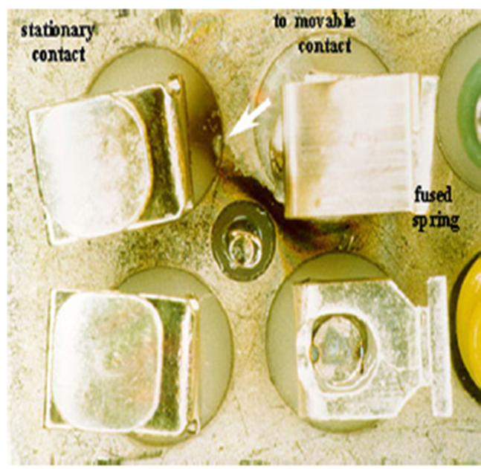
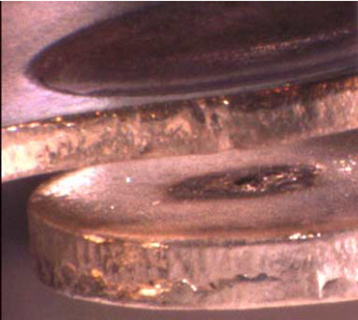
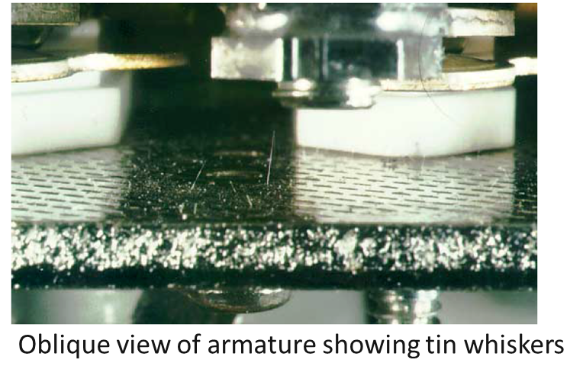
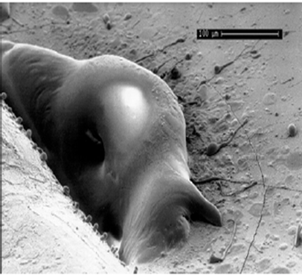
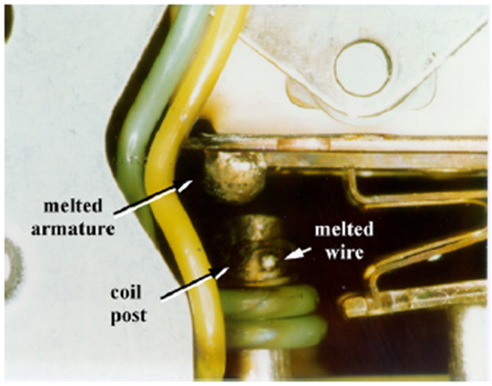
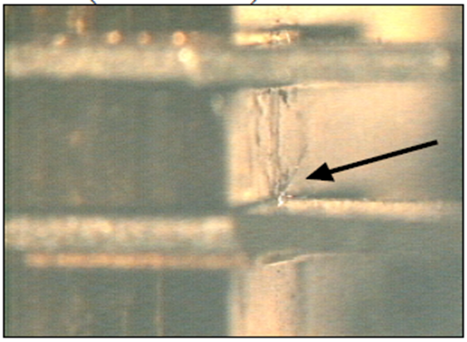
Failure Modes of EMRs
Parts
 |  | Failure symptoms | Mode of failures
Contact |  | Transfer and wear of contact metal due to arc discharge. Sticking of contact. Corrosion (oxidation, sulfurization, etc.). Foreign matter (dust, etc.). Deposits. | Poor release (welding, locking). Poor contact. Increased contact resistance. Noise. Change in operate/release voltages and times. Poor dielectric strength.
Winding |  | Corrosion. Galvanic corrosion. Foreign matter (dust, etc.). Voltage fluctuation. Vibration of lead wire. | Breakage of coil, short-circuit of coil. Burning of coil. Poor working release operation. Change in operate/release voltage. Change in operate/release time beat. Malfunction.
Structural parts (spring, sliding parts, insulation etc.) |  | Slip-off and wear of contact piece. Fatigue and creep of spring. Abnormal wear and loosing. Seize. Deterioration of organic material. Deposition of worn contact material powders. Corrosion and galvanic corrosion. Foreign matter (dust, etc.). | Poor contact. Poor release operation. Change in operate/release voltage. Change in operate/release time beat. Degradation in insulation resistance. Poor dielectric strength.
Enclosure |  | Damage by external force. Change in chemical properties. | Damage
Source: Lacombe, D., Farhat, L., “Relays: Failures occurring & Lesson learnt.” In ESA-ESTEC, 2018

Slide 5
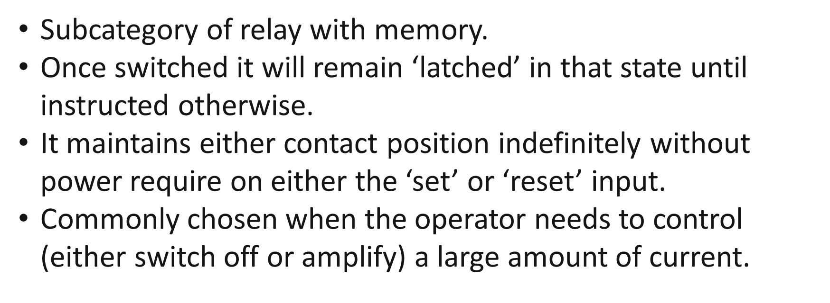
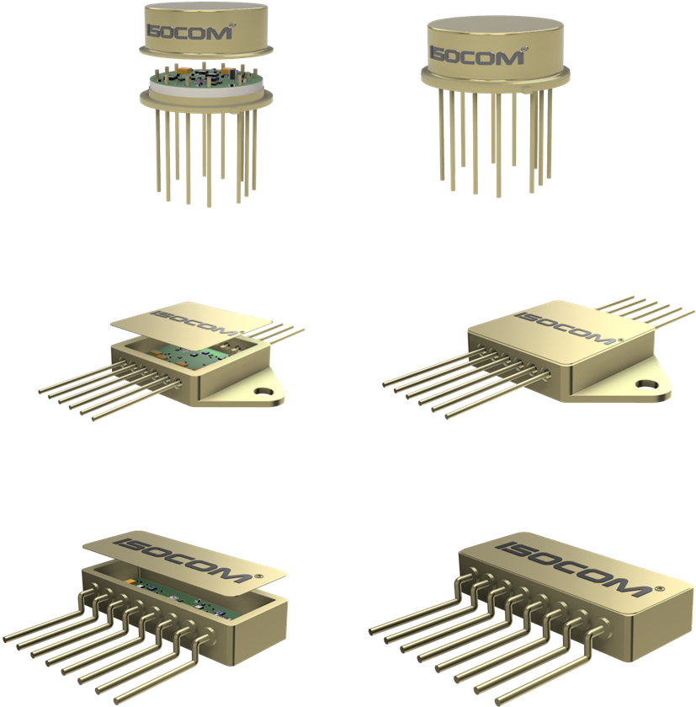
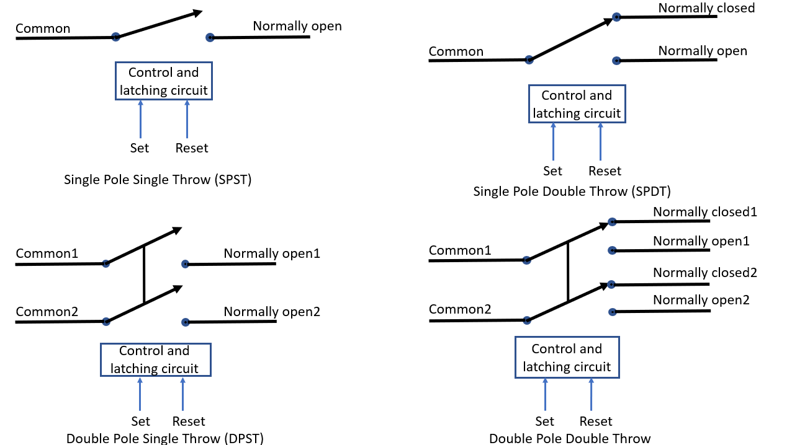
The Isocom Latching Solid-State Relay Development
(DPDT)

Slide 6
Summary of LSSR developments
Development 1 | Development 2 | Development 3
Requires a Vcc (5VDC) | Does not require a Vcc | Does not require a Vcc
Latch draws 10mA from Vcc in Latch mode | Fixed Voltage at output stage (28V example) | 10 to 50V range on the output
Latch draws 7mA from Vcc in Reset mode | Latch draws 5.5mA (@ 28V) from the XVBus in Latch mode | Latch draws from 4.0mA (@ 10V) to 7.0mA (@ 50V) from the XVBus in Latch mode
Output Voltages and Currents can be selected by user when ordering (limited by package) | Latch draws 0.7mA (@ 28V) from XVBus in Reset mode | Latch draws from 0.2mA (@ 10V) to 2.7mA (@ 50V) from the XVBus in Reset mode
High side and low side switching | For low side switching | For low side switching
 | Output Currents can be selected by user when ordering (limited by package) | Output Currents can be selected by user when ordering (limited by package)

Slide 7
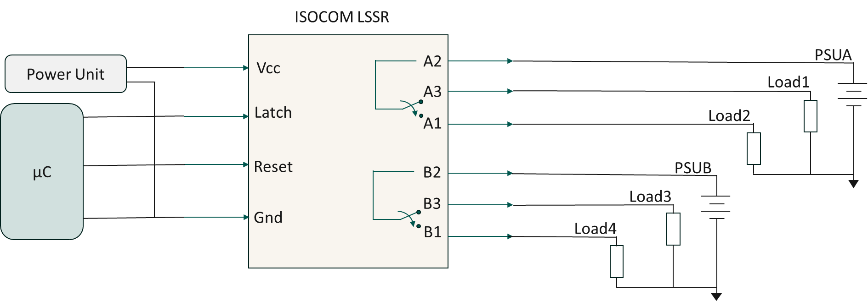
Development 1 Using V_{CC} Supply
ISOCOM LSSR
ESCC LMR
B1
-X2
B2
B3
Similarities
Both require 10 pins
A2 = Output1
A3 = Normally Closed 1
A1 = Normally Open 1
B2 = Output 2
B3 = Normally Closed 2
B1 = Normally Open 2
Vcc
A2
Changes to be made from ESCC to ISOCOM
+X1 = Latch
+Y1 = Reset
-X2 = Vcc
-Y2 = Gnd
A3
Latch
A1
-Y2
+Y1
Reset
B2
Gnd
B3
A2
B1
A1
+X1
A3
Application for High Side Switching

Slide 8
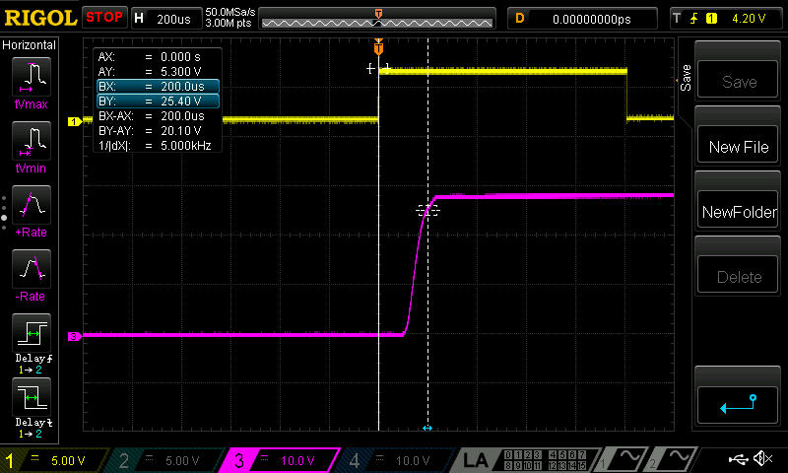
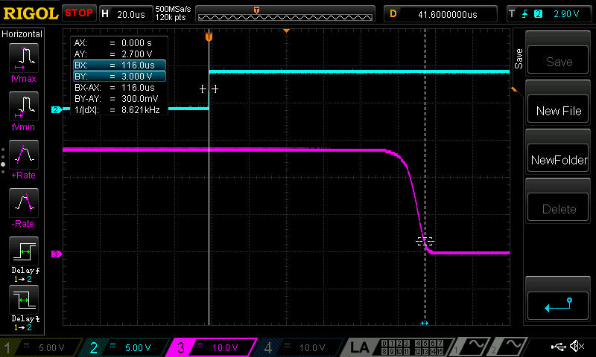
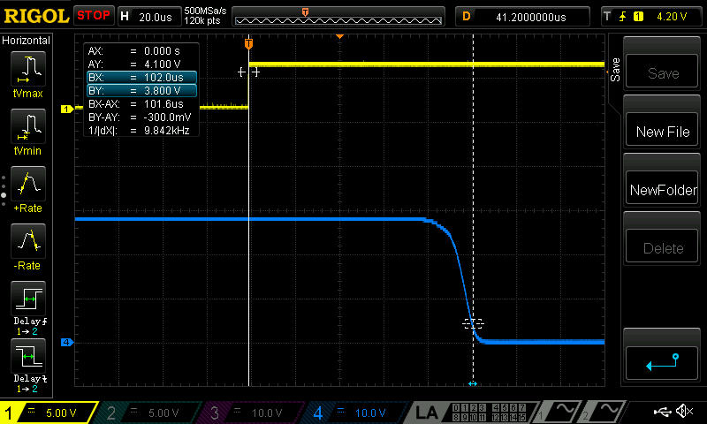
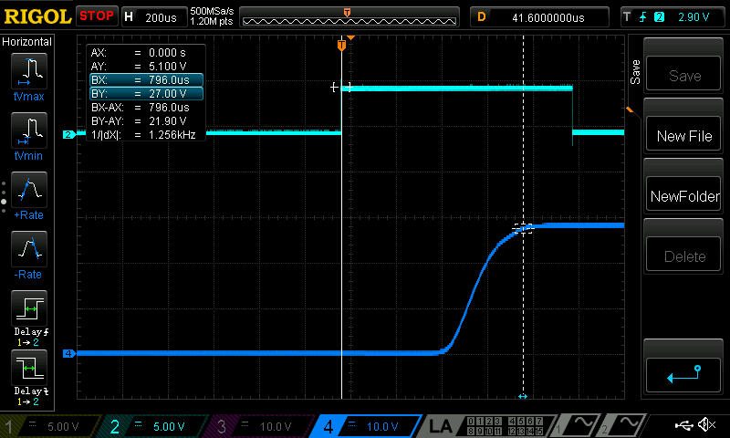
Development 1 (Application) Test Results
Set to NO
Reset to NO
V_{CC} = 5V
I_{CC}(Latch) = 10mA
I_{CC}(Reset) = 7mA
V_{O} = 28V (PSUA, PSUB)
I_{O} = 1.16A
R_{L} = 24Ω (loads 1 to 4)
Set to NC
Reset to NC
Set |  | Reset
NO | NC | NO | NC
200µs | 102µs | 116µs | 796µs

Slide 9
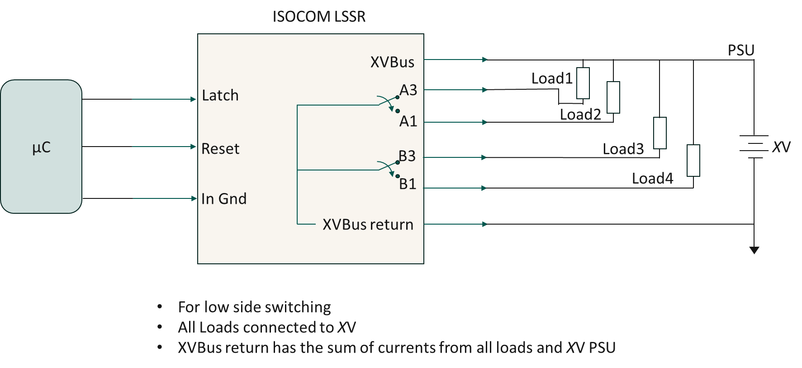
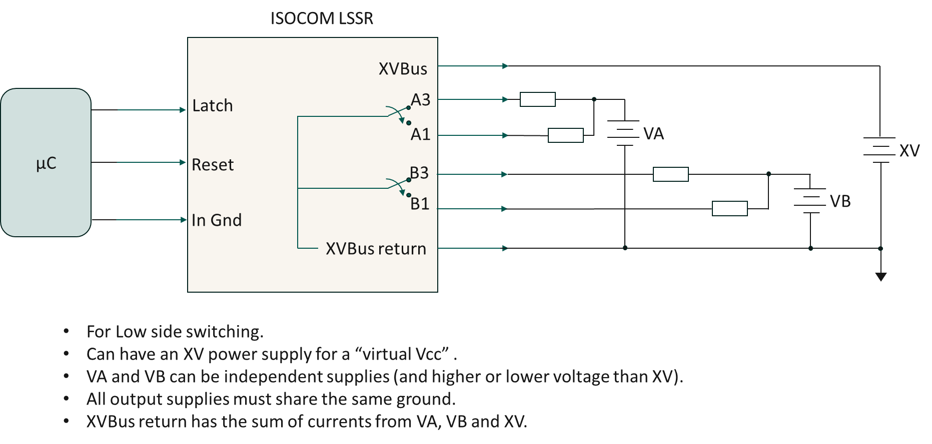
Development 2 Without V_{CC} Fixed Voltage Output
Similarities
10 pins required (XVBus return = A2 and B2)
A3 = Normally Closed 1
A1 = Normally Open 1
B3 = Normally Closed 2
B1 = Normally Open 2
ISOCOM LSSR
ESCC LMR
B1
-X2
B2
B3
Changes to be made from ESCC to ISOCOM
+X1 = Latch
+Y1 = Reset
-X2 = GnD
-Y2 = XVBus
A2 and B2 made common to create XVBus return
XVBus
Latch
A3
A1
-Y2
+Y1
Reset
B3
In Gnd
B1
XVBus is hard set (i.e., 5, 12, 28, 48 V etc.).
Does not require an additional Vcc.
Both Poles switching the XVBus return (output Gnd).
Can go up to high currents (up to 20A) package dependent.
XVBus return
A1
+X1
A2
A3

Slide 10
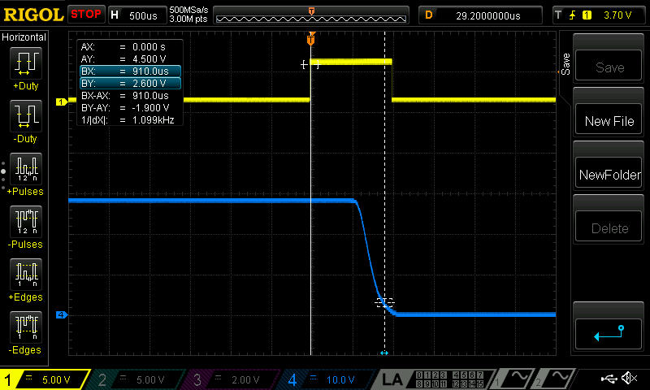
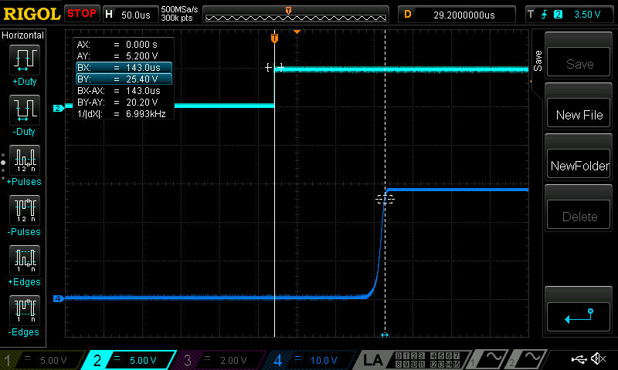
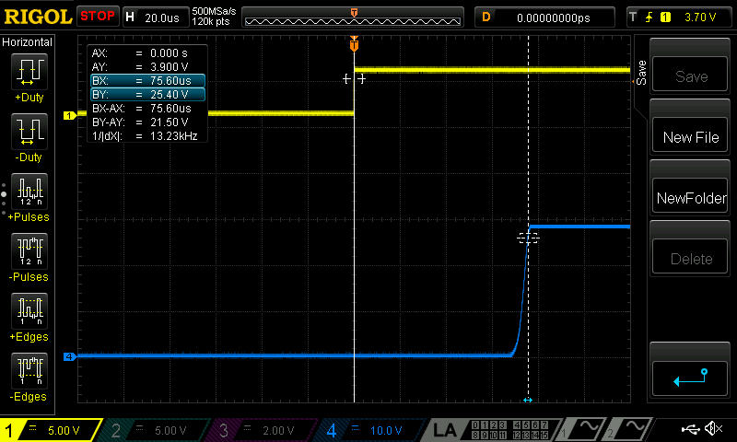
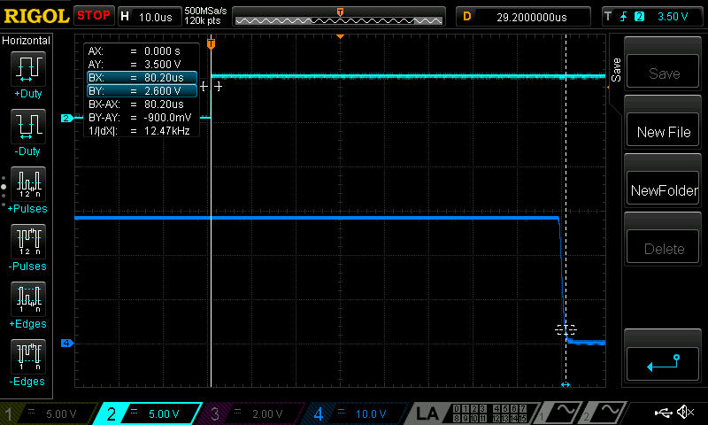
Development 2 (Application 2) Test Results
Set to NO
Reset to NO
Vbus = 28V
IXV_{Latch} = 5.5mA
IXV_{Reset} = 0.7mA
Vout = 28V
Iout = 1.16A
RL = 24Ω
Set |  | Reset
NO | NC | NO | NC
910µs | 75µs | 143µs | 80µs
Set to NC
Reset to NC

Slide 11
Development 3 Without VCC (10 to 50V)
ISOCOM LSSR
ESCC LMR
XVBus
B1
-X2
B2
B3
Latch
A3
A1
Reset
-Y2
+Y1
B3
B1
In Gnd
XVBus return
A1
+X1
A2
A3
XVBus is no longer set, it can be between 10 and 50V.
Does not require an additional Vcc.
Both Poles switching the XVBus return (output Gnd).
Applications the same as Development 2.

Slide 12
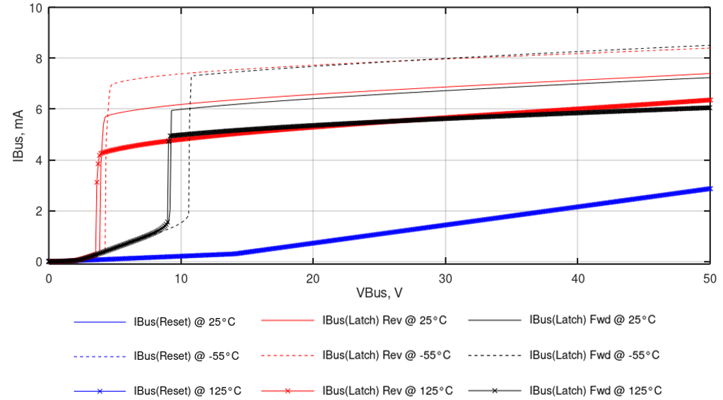
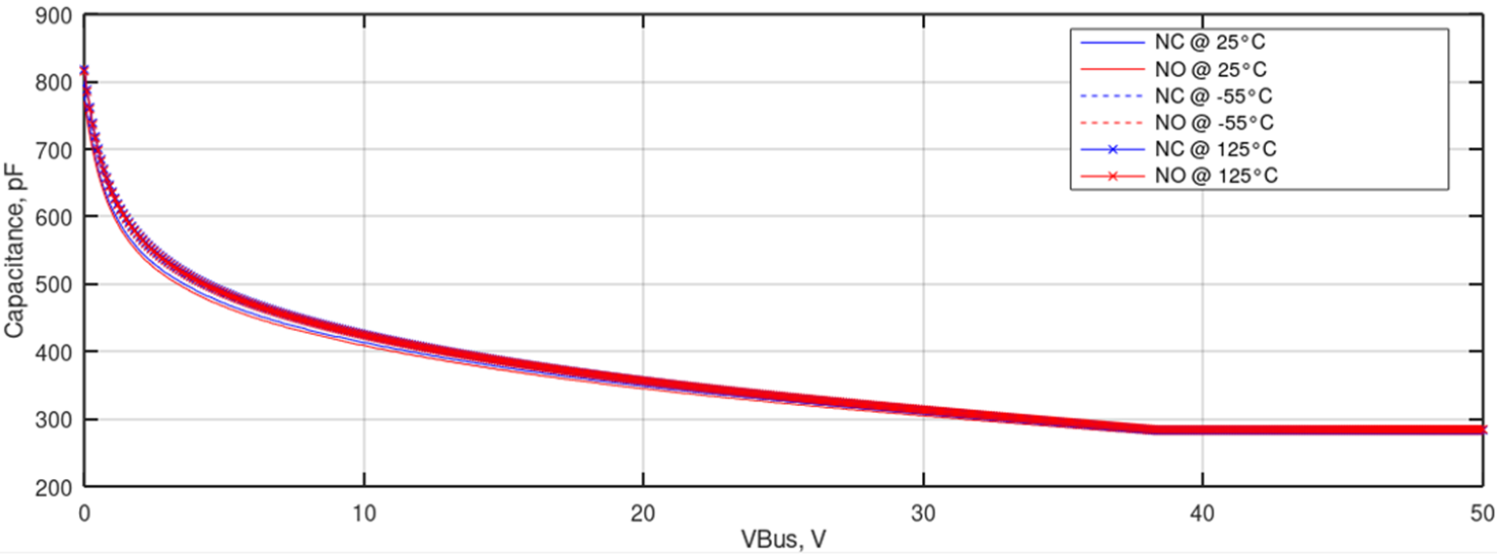
Development 3 Test Results
Current and Voltage vs Temperature
NO and NC Output Capacitance VS.
Temperature and XVBus voltage
Minimum voltage on XVBus to unlatch once in latch mode = 3 to 4V
Minimum voltage on XVBus to latch = 9V

Slide 13
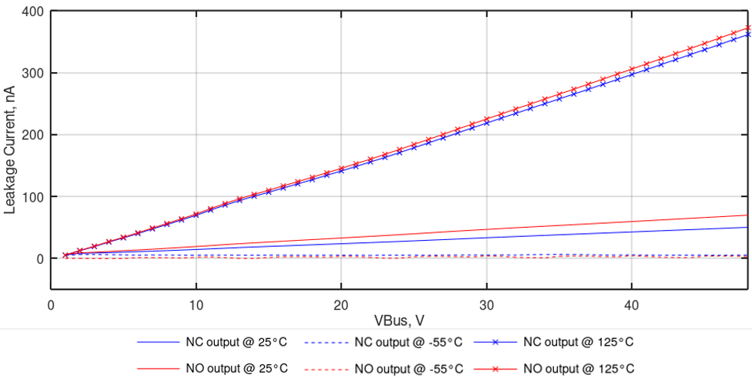
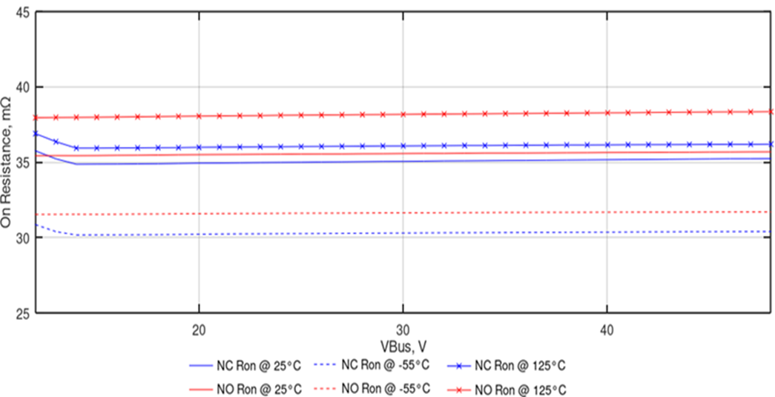
Development 3 Test Results continued
NO and NC OFF state leakage current VS.
Temperature and XVBus voltage

Slide 14
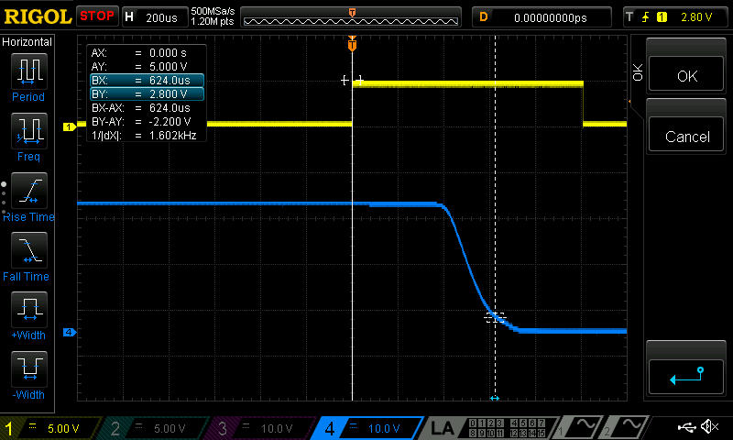
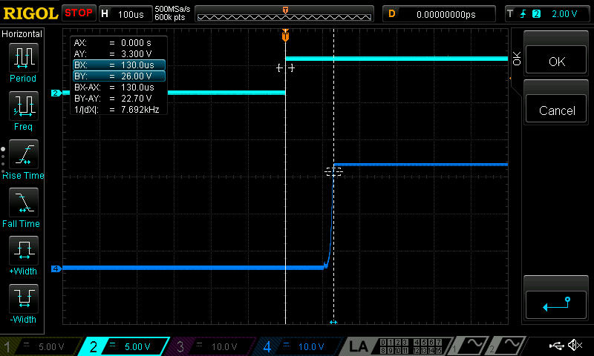
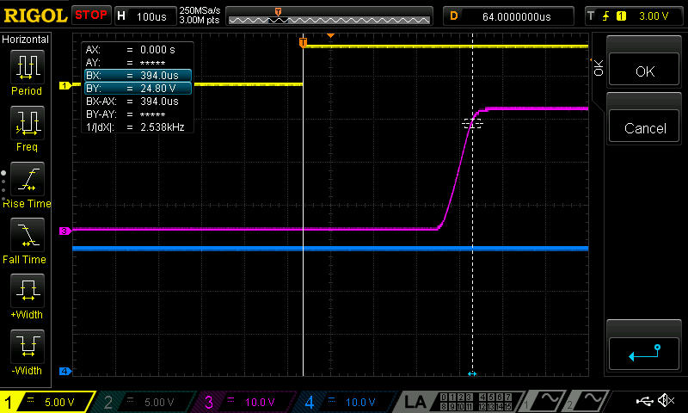
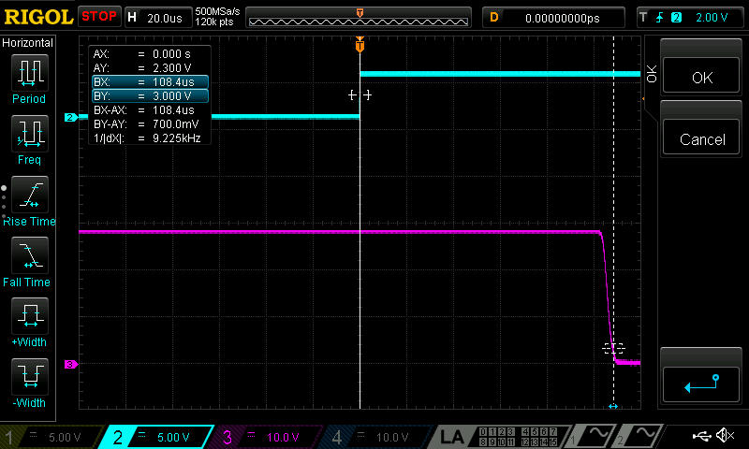
Development 3 (Application 2) Timing Test Results
Latch to NO
Reset to NO
Vbus = 28V
ILatch = 6.9mA
Ireset = 1.8mA
Vout = 28V
Iout = 1.16A
RL = 24Ω
Latch to NC
Reset to NC
Latch |  | Reset
NO | NC | NO | NC
624µs | 394µs | 130µs | 108µs

Slide 15
Summary of Development 1, 2 and 3 Current/Voltage and Timing Results
Development | V_{CC}/XVbus [V] | I_{CC}/I_{BUS}(Latched) [mA] | I_{CC}/I_{BUS}(Reset) [mA]
1 | 5 | 21.4 | 11.5
2 | 28 | 5.2 | 0.7
3 | 10 - 50 | 5.6 – 6.2 | 0.2 – 2.8
Set |  |  | Reset
Development | NO | NC | NO | NC
1 | 200µs | 102µs | 116µs | 796µs
2 | 910µs | 75µs | 143µs | 80µs
3 | 624µs | 394µs | 130µs | 108µs
Note: These are only preliminary results and are subject to improvements.

Slide 16
Comparison of ISOCOM LSSR and ESCC EMLR
Characteristics | ISOCOM 28V 10A (Power Controller) | ISOCOM 28V 10A (Fixed voltage) | ISOCOM 10A (10 to 50V range) | ESCC 28V 1A | ESCC 28V 2A | ESCC 28V 10A | ESCC 28V 15A
Latch Voltage | 3.3 to 5V | 3.3 to 5V | 3.3 to 5V | 4.5 to 18V | 3.2 to 13.5V | 9 to 18V | 9 to 18V
Reset Voltage | 3.3 to 5V | 3.3 to 5V | 3.3 to 5V | 4.5 to 18V | 3.2 to 13.5V | 9 to 18V | 9 to 18V
Latch Time** | (NO) 200µS, (NC) 102µS | (NO) 910µS, (NC) 75µS | (NO) 624µS, (NC) 394µS | 3ms | 4ms | 15ms | 15ms
Reset Time** | (NO) 116µs, (NC) 796µs | (NO) 143µs, (NC) 80µs | (NO) 130µs, (NC) 108µs | 3ms | 4ms | 15ms | 15ms
Bounce Time | NA | NA | NA | 1.5ms | 2ms | 1ms | 1ms
Contact Voltage Drop** | 196mV @ 5A | 196mV @ 5A | 196mV @ 5A | 10mV @ 100mA | 5mV @ 100mA | 75mV @ 5A | 50mV @ 5A
** Latest development of the output stage to the ISOCOM LSSRs is showing an improvement in Latch/Reset time. Furthermore, the ON resistance of the output stage has been reduced thereby decreasing the Contact Voltage Drop.

Slide 17
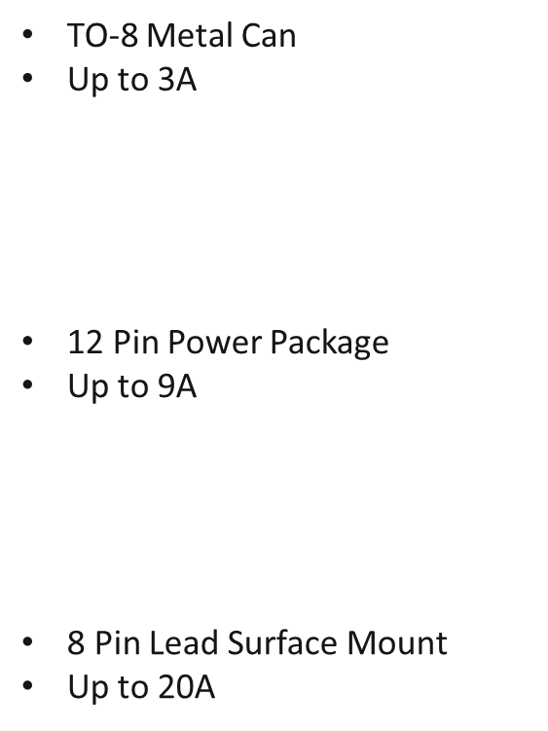
ISOCOM LSSR Package Styles
Equivalent to ESA3602/001
Up to 10A
Up to 50A
Equivalent to ESA3602/014

Slide 18
Conclusions
Solid State Relays (SSRs) have a higher reliability compared to the electromechanical Relay (EMR).
Hence, SSRs are set to replace EMRs in terrestrial and space applications (where high reliability is essential)
ISOCOM have developed high reliability latching SSRs
Available in several styles: (SPST) (SPDT) (DPST) (DPDT) (QPST) (QPDT)
Power Management Latching Solid State Relay (Development 1)
Requires an external Vcc
Designed for high side switching
Sub millisecond switching times
Various output currents and voltages offered
Latching Solid State Relay (Development 2 and 3)
No Vcc required
Designed for low side switching
Sub millisecond switching times
Available in fixed output voltages (12V, 24V, 28V, 48V) or full voltage range (10 to 50V)
Various output currents offered
Tested to be stable across output voltages and ambient temperatures (-55°C to +125°C)
Development at ISOCOM is ongoing to improve performance

Slide 19
Thank You For Your Attention
For further information please visit our website @ https://www.isocom.uk.com
Please do not hesitate to contact us.

